Slide 1
Basic Probability

Slide 2
Learning Objectives
In this chapter, you learn:
Basic probability concepts
Calculating probabilities of events
Joint events
Conditional probability
Decision trees

Slide 3
Probability
Probability is the branch of mathematics concerning numerical descriptions of how likely an event is to occur, or how likely it is that a proposition is true. The probability of an event is a number between 0 and 1, where, roughly speaking, 0 indicates impossibility of the event and 1 indicates certainty. The higher the probability of an event, the more likely it is that the event will occur. A simple example is the tossing of a fair (unbiased) coin. Since the coin is fair, the two outcomes ("heads" and "tails") are both equally probable; the probability of "heads" equals the probability of "tails"; and since no other outcomes are possible, the probability of either "heads" or "tails" is 1/2 (which could also be written as 0.5 or 50%).

Slide 4
Basic Probability Concepts
Probability – the chance that an uncertain event will occur (always between 0 and 1)
Impossible Event – an event that has no chance of occurring (probability = 0)
Certain Event – an event that is sure to occur (probability = 1)

Slide 5
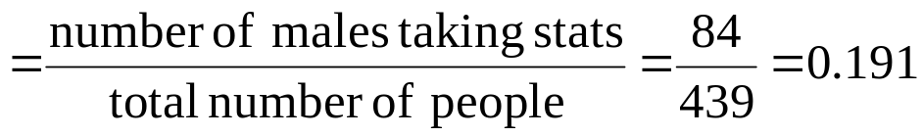
Example
Find the probability of selecting a male taking statistics from the population described in the following table:
 | Taking Stats | Not Taking Stats | Total
Male | 84 | 145 | 229
Female | 76 | 134 | 210
Total | 160 | 279 | 439
Probability of male taking stats

Slide 6
Events
Each possible outcome of a variable is an event.
Simple event
  An event described by a single characteristic
  e.g., A day in January from all days in 2019
Joint event
  An event described by two or more characteristics
  e.g. A day in January that is also a Wednesday from all days in 2019
Complement of an event A (denoted A’)
  All events that are not part of event A
  e.g., All days from 2019 that are not in January

Slide 7

Sample Space
The Sample Space is the collection of all possible events
e.g. All 6 faces of a die:
e.g. All 52 cards of a bridge deck:

Slide 8
Organizing & Visualizing Events
Contingency Tables -- For All Days in 2019
Decision Trees
Jan. Not Jan. Total
Wed. 5 47 52
Not Wed. 27 286 313
Total 32 333 365
5
27
47
286
Total
Number
Of
Sample
Space
Outcomes
Wed.
Sample Space
Jan.
All Days
In 2019
Not Wed.
Wed.
Not Jan.
Not Wed.

Slide 9
Definition: Simple Probability
Simple Probability refers to the probability of a simple event.
  ex. P(Jan.)
  ex. P(Wed.)
Jan. Not Jan. Total
P(Wed.) = 52 / 365
Wed. 5 47 52
Not Wed. 27 286 313
Total 32 333 365
P(Jan.) = 32 / 365

Slide 10
Definition: Joint Probability
Joint Probability refers to the probability of an occurrence of two or more events (joint event).
  ex. P(Jan. and Wed.)
  ex. P(Not Jan. and Not Wed.)
Jan. Not Jan. Total
P(Not Jan. and Not Wed.)
= 286 / 365
Wed. 5 47 52
Not Wed. 27 286 313
Total 32 333 365
P(Jan. and Wed.) = 5 / 365

Slide 11
Mutually Exclusive Events
Mutually exclusive events
  Events that cannot occur simultaneously
Example: Randomly choosing a day from 2019
  A = day in January; B = day in February
  Events A and B are mutually exclusive

Slide 12
Collectively Exhaustive Events
Collectively exhaustive events
  One of the events must occur
  The set of events covers the entire sample space
Example: Randomly choose a day from 2019
A = Weekday; B = Weekend;
C = January; D = Spring;
  Events A, B, C and D are collectively exhaustive (but not mutually exclusive – a weekday can be in January or in Spring)
  Events A and B are collectively exhaustive and also mutually exclusive

Slide 13
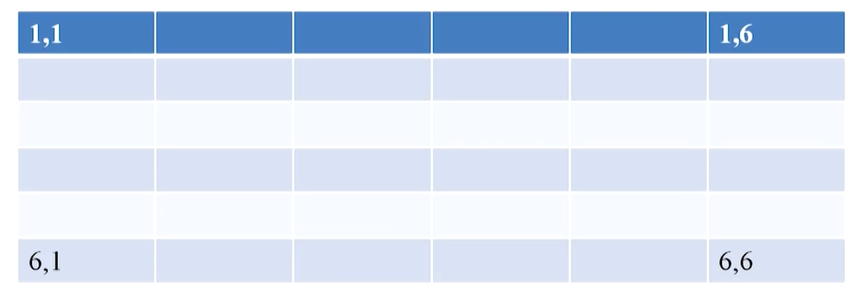
Example

Slide 14
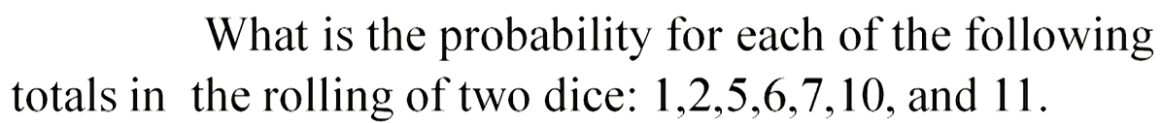
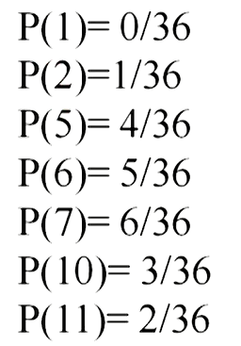
Cont’d…

Slide 15
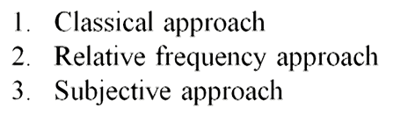
Types of Probability

Slide 16
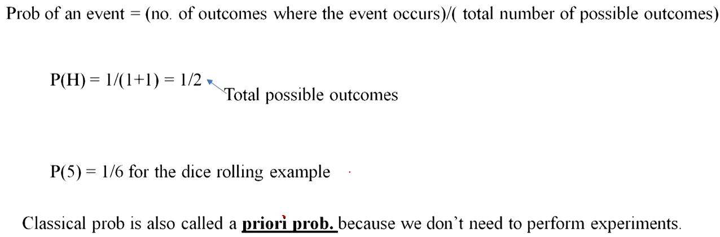
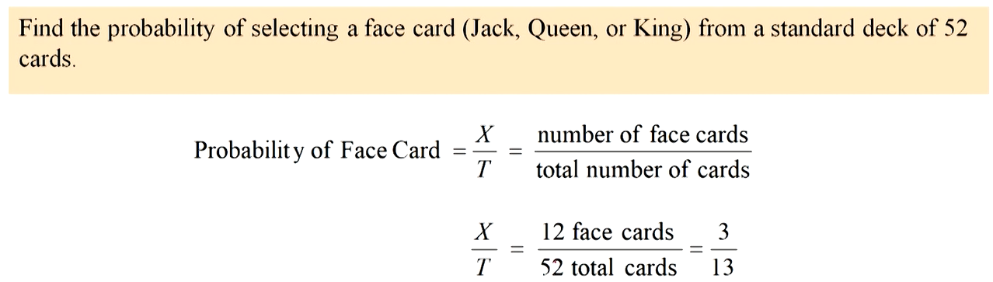
Classical approach

Slide 17
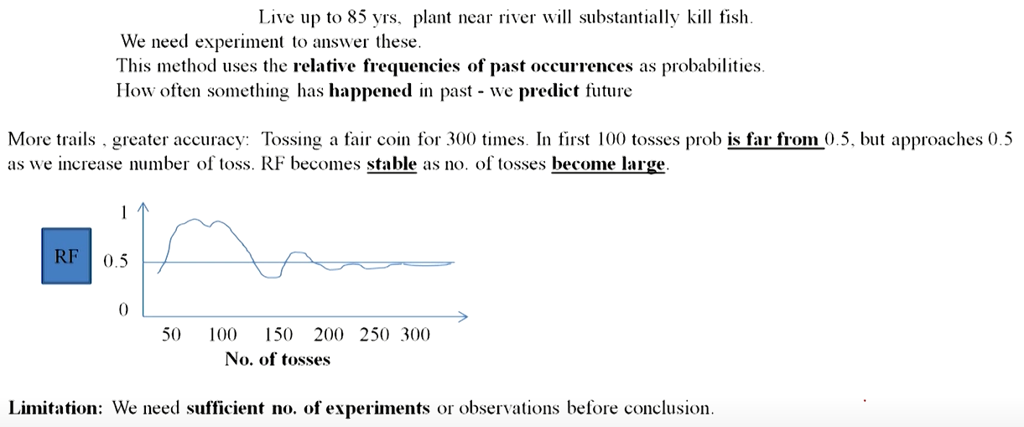
Relative Frequency

Slide 18

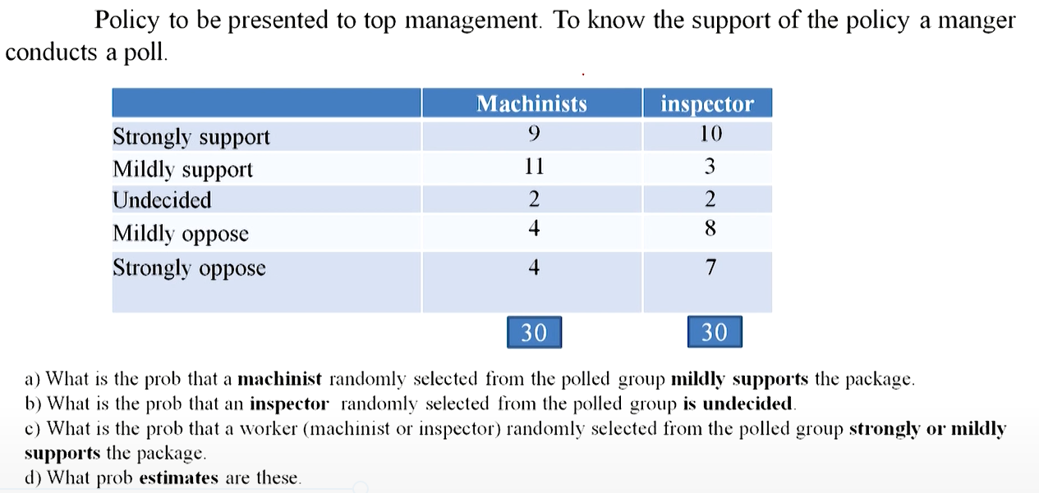
Subjective approach

Slide 19
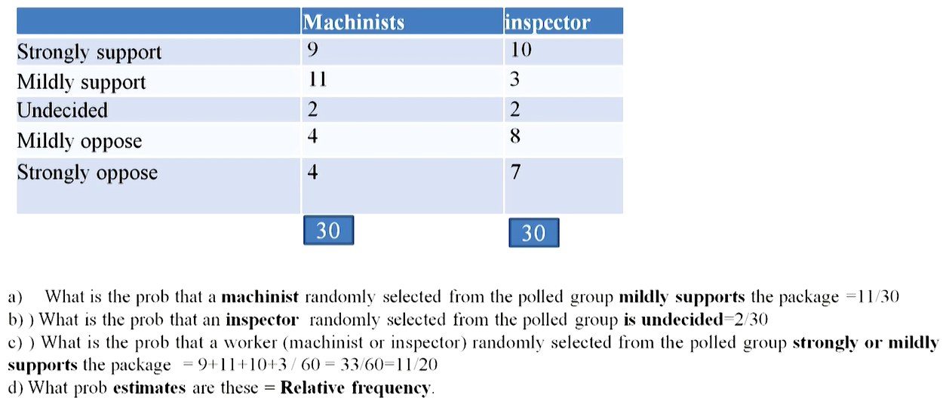
Answer

Slide 20
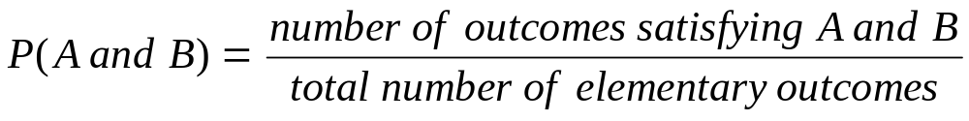
Computing Joint and
Marginal Probabilities
The probability of a joint event, A and B:
Computing a marginal (or simple) probability:
    Where B₁, B₂, …, B_{k} are k mutually exclusive and collectively exhaustive events

Slide 21
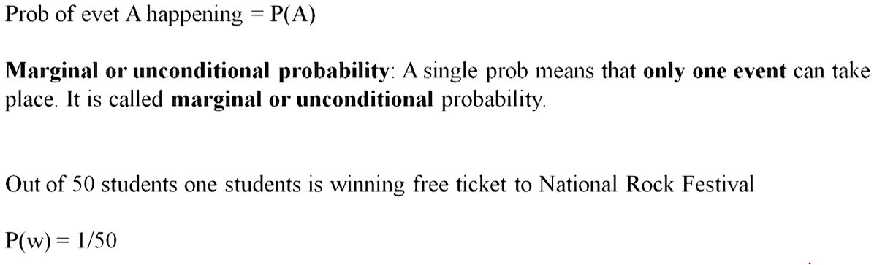

Slide 22
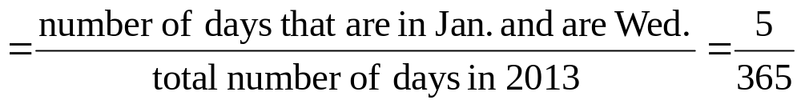
Joint Probability Example
P(Jan. and Wed.)
Jan. Not Jan. Total
Wed. 5 47 52
Not Wed. 27 286 313
Total 32 333 365

Slide 23
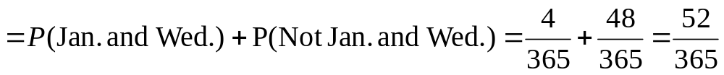
Marginal Probability Example
P(Wed.)
Jan. Not Jan. Total
Wed. 4 48 52
Not Wed. 27 286 313
Total 31 334 365

Slide 24
Marginal & Joint Probabilities In A Contingency Table
Event
Event
B₁
B₂
Total
A₁
P(A₁ and B₁)
P(A₁ and B₂)
P(A₁)
A₂
P(A₂ and B₁)
P(A₂ and B₂)
P(A₂)
Total
P(B₁)
P(B₂)
1
Joint Probabilities
Marginal (Simple) Probabilities

Slide 25

Probability Summary So Far
Probability is the numerical measure of the likelihood that an event will occur
The probability of any event must be between 0 and 1, inclusively
The sum of the probabilities of all mutually exclusive and collectively exhaustive events is 1
1
Certain
0 ≤ P(A) ≤ 1 For any event A
0.5
0
Impossible
If A, B, and C are mutually exclusive and collectively exhaustive

Slide 26
General Addition Rule
General Addition Rule:
P(A or B) = P(A) + P(B) - P(A and B)
If A and B are mutually exclusive, then
P(A and B) = 0, so the rule can be simplified:
P(A or B) = P(A) + P(B)
For mutually exclusive events A and B

Slide 27
General Addition Rule Example
P(Jan. or Wed.) = P(Jan.) + P(Wed.) - P(Jan. and Wed.)
= 32/365 + 52/365 - 5/365 = 79/365
Don’t count the five Wednesdays in January twice!
Jan. Not Jan. Total
Wed. 5 47 52
Not Wed. 27 286 313
Total 32 333 365

Slide 28
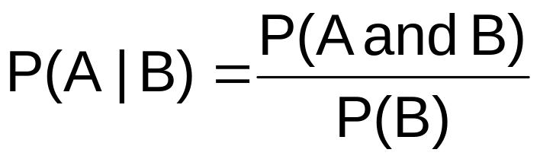
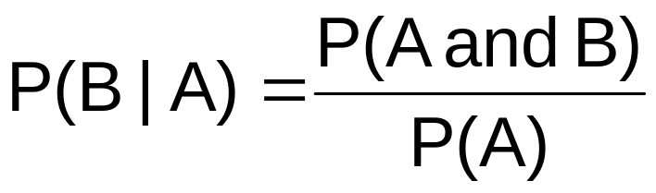
Computing Conditional Probabilities
A conditional probability is the probability of one event, given that another event has occurred:
The conditional probability of A given that B has occurred
The conditional probability of B given that A has occurred
Where P(A and B) = joint probability of A and B
P(A) = marginal or simple probability of A
P(B) = marginal or simple probability of B

Slide 29
Conditional Probability Example
Of the cars on a used car lot, 70% have air conditioning (AC) and 40% have a GPS. 20% of the cars have both.
What is the probability that a car has a GPS, given that it has AC ?
i.e., we want to find P(GPS | AC)

Slide 30

Conditional Probability Example
(continued)
Of the cars on a used car lot, 70% have air conditioning (AC) and 40% have a GPS and
20% of the cars have both.
GPS
No GPS
Total
AC
0.2
0.5
0.7
No AC
0.2
0.1
0.3
Total
0.4
0.6
1.0

Slide 31
Conditional Probability Example
(continued)
Given AC, we only consider the top row (70% of the cars). Of these, 20% have a GPS. 20% of 70% is about 28.57%.
GPS
No GPS
Total
AC
0.2
0.5
0.7
No AC
0.2
0.1
0.3
Total
0.4
0.6
1.0

Slide 32




Using Decision Trees
Given AC or no AC:
Has GPS
P(AC and GPS) = 0.2
P(AC)= 0.7
Does not have GPS
P(AC and GPS’) = 0.5
Has AC
All
Cars
Conditional
Probabilities
Does not have AC
P(AC’ and GPS) = 0.2
Has GPS
P(AC’)= 0.3
Does not have GPS
P(AC’ and GPS’) = 0.1

Slide 33



Using Decision Trees
(continued)
Given GPS or no GPS:
Has AC
P(GPS and AC) = 0.2
P(GPS)= 0.4
Does not have AC
P(GPS and AC’) = 0.2
Has GPS
All
Cars
Conditional
Probabilities
Does not have GPS
Has AC
P(GPS’ and AC) = 0.5
P(GPS’)= 0.6
Does not have AC
P(GPS’ and AC’) = 0.1

Slide 34

Independence
Two events are independent if and only if:
Events A and B are independent when the probability of one event is not affected by the fact that the other event has occurred

Slide 35
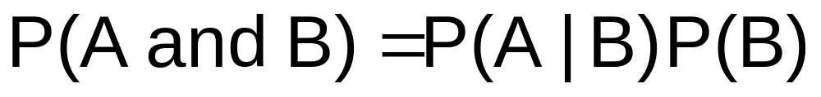

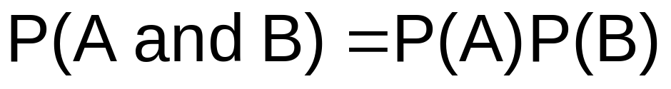
Multiplication Rules
Multiplication rule for two events A and B:
Note: If A and B are independent, then
and the multiplication rule simplifies to

Slide 36
Bayes Formula

Slide 37
Bayes’ Theorem
Bayes’ Theorem is used to revise previously calculated probabilities based on new information.
Developed by Thomas Bayes in the 18th Century.
It is an extension of conditional probability.

Slide 38
Example
There exists a test for a certain viral infection. It is 95% reliable for infected patients and 99% reliable for the healthy ones. That is, if a patient has the virus (event V), the test shows that (event S) with probability P{S | V} = 0.95, and if the patient does not have the virus, the test shows that with probability P{not S | not V} = 0.99. Suppose that 4% of all the patients are infected with the virus, P{V} = 0.04. When the test shows positive result, find the (conditional) probability that the patient is infected.

Slide 39
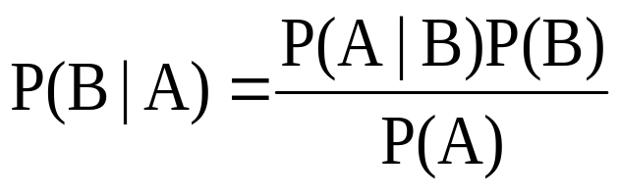
Bayes’ Theorem
How to find P(A)?

Slide 40
Marginal Probability
(The Law of Total Probability)
Marginal probability for event A:
  Where B₁, B₂, …, B_{k} are k mutually exclusive and collectively exhaustive events

Slide 41
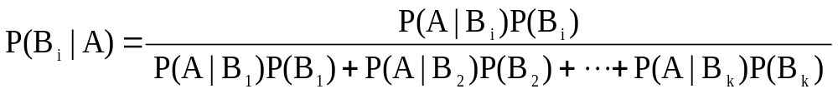
Bayes’ Theorem
where:
B_{i} = i^{th} event of k mutually exclusive and collectively
exhaustive events
A = new event that might impact P(B_{i})

Slide 42

Bayes’ Theorem Example
A drilling company has estimated a 40% chance of striking oil for their new well.
A detailed test has been scheduled for more information. Historically, 60% of successful wells have had detailed tests, and 20% of unsuccessful wells have had detailed tests.
Given that this well has been scheduled for a detailed test, what is the probability
that the well will be successful?

Slide 43
Bayes’ Theorem Example
(continued)
Let S = successful well
U = unsuccessful well
P(S) = 0.4 , P(U) = 0.6 (prior probabilities)
Define the detailed test event as D
Conditional probabilities:
    P(D|S) = 0.6 P(D|U) = 0.2
Goal is to find P(S|D)

Slide 44
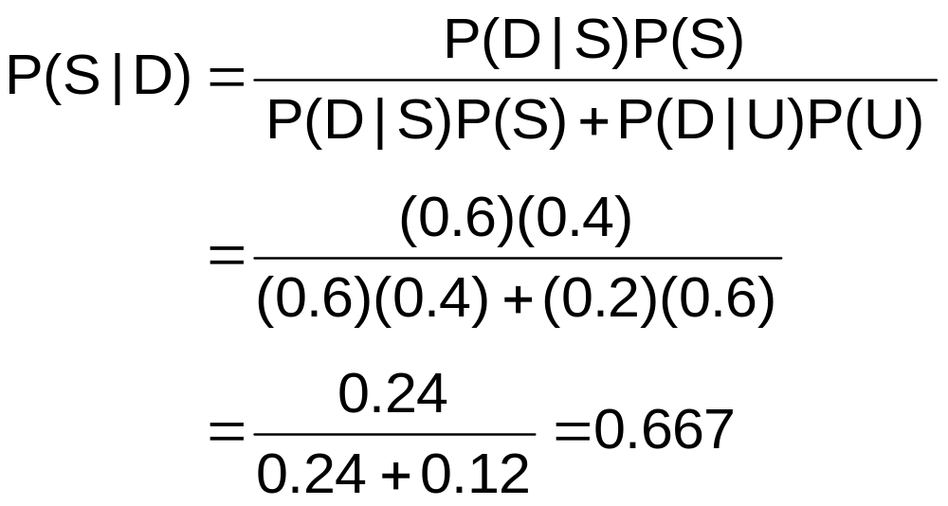
Bayes’ Theorem Example
(continued)
Apply Bayes’ Theorem:
So the revised probability of success, given that this well has been scheduled for a detailed test, is 0.667

Slide 45
Bayes’ Theorem Example
(continued)
Given the detailed test, the revised probability of a successful well has risen to 0.667 from the original estimate of 0.4
Event | Prior Prob. | Conditional Prob. | Joint Prob. | Revised Prob.
S (successful) | 0.4 | 0.6 | (0.4)(0.6) = 0.24 | 0.24/0.36 = 0.667
U (unsuccessful) | 0.6 | 0.2 | (0.6)(0.2) = 0.12 | 0.12/0.36 = 0.333
Sum = 0.36

Slide 46
Exercises
All athletes at the Olympic games are tested for performance-enhancing steroid drug use. The imperfect test gives positive results (indicating drug use) for 90% of all steroid-users but also (and incorrectly) for 2% of those who do not use steroids. Suppose that 5% of all registered athletes use steroids. If an athlete is tested positive, what is the probability that he/she uses steroids?

Slide 47
Summary
In this chapter we discussed:
Basic probability concepts
  Sample spaces and events, contingency tables, simple probability, and joint probability
Basic probability rules
  General addition rule, addition rule for mutually exclusive events, rule for collectively exhaustive events
Conditional probability
  Statistical independence, marginal probability, decision trees, and the multiplication rule
Bayes Formula and the Law of Total Probability

